Slide 1
MGMT-6064 PROJECT LEADERSHIP AND MANAGEMENT
Module 5: Leadership Styles

Slide 2
Objectives
What is ‘Leadership Style’?
Lewin’s Three Leadership Styles
Blake and Mouton Managerial Grid
Situational Leadership Model
Goleman’s Six Leadership Styles
Servant Leadership
Implications for Project Leaders

Slide 3

What is ‘leadership style’?
A leader’s style is his/her manner of behaving, interacting with, making decisions, and motivating others
Leadership style consists of behavioural patterns that are influenced by the leader’s personality, the people being led, and the (organizational and environmental) situation
Notes:
Image: https://www.linkedin.com/media-proxy/ext?w=1200&h=675&hash=Z%2F627oE%2BJY%2BpKQqM3Bq1Feg230k%3D&ora=1%2CaFBCTXdkRmpGL2lvQUFBPQ%2CxAVta5g-0R6plxVUzgUv5K_PrkC9q0RIUJDPBy-nXyCq-9afZnPsecbcZLSiolgReCoBlAIyf-ygRDjkFY69LcLmY4Yx3A

Slide 4
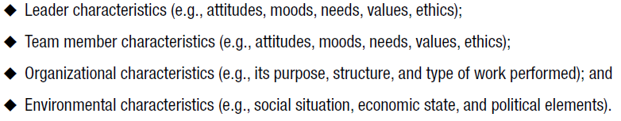
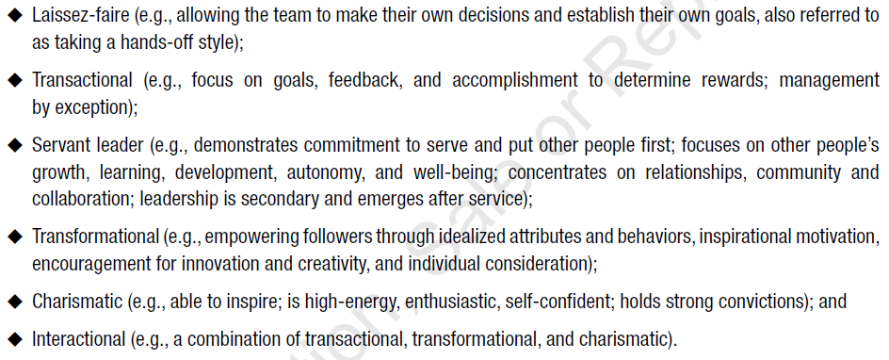
Pmbok – leadership styles
Appropriate leadership style depends on:
Leadership Styles
Notes:
Source: PMBOK 6e p. 65

Slide 5
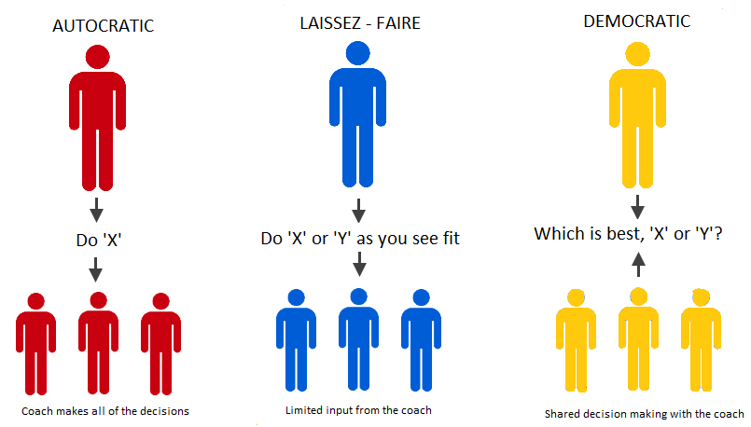
Lewin’s leadership styles
First major study of leadership styles (late 1930s)
Three main leadership styles can fall anywhere on the continuum of:
Autocratic
Democratic
Laissez-faire
(video)
Notes:
Image: http://3.bp.blogspot.com/-XWzA6NBLu18/VWe8YT6bv5I/AAAAAAAAABY/Ny7duIeqCDQ/s1600/Coaching-Styles.png

Slide 6

Autocratic project management
Advantages
Faster decision making
Motivates team (the leader is watching the team members)
Less stress (team members don’t have to make decisions)
Disadvantages
Communication is one-way
Resentment and fear
Dependency culture
Notes:
Image: http://www.assignmentpoint.com/wp-content/uploads/2017/11/Autocratic-Decision-Making.jpg
Information source: Expert Program Management (https://expertprogrammanagement.com/2010/06/leadership-styles-lewin-theory-lewin/)

Slide 7

Democratic Project management
Advantages
Good working environment (team members feel that their input is valued)
Better quality decisions
Creative culture
Disadvantages
Slower decision-making
Leader ‘hides’ within the team
Notes:
Image: https://image.slidesharecdn.com/leadership-style-160215143001/95/leadership-style-7-638.jpg?cb=1455546642
Information source: Expert Program Management (https://expertprogrammanagement.com/2010/06/leadership-styles-lewin-theory-lewin/)

Slide 8

Laissez-faire Project management
Advantages
Team member freedom & flexibility
Less work for leader (can add value to project elsewhere)
Disadvantages
Team members may not be capable of self-managing
Lack of ownership or responsibility
Notes:
Image: http://1.bp.blogspot.com/_FC6XAB8Ugc0/TIY34_qlbDI/AAAAAAAAAT0/siYBlF_eM8w/s1600/lazy_worker_small1.jpg
Information source: Expert Program Management (https://expertprogrammanagement.com/2010/06/leadership-styles-lewin-theory-lewin/)

Slide 9
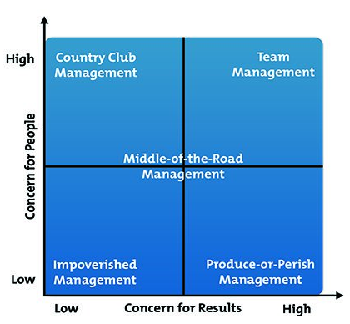
blake & mouton Managerial grid (1960s)
Model for understanding your leadership style (and leadership styles of others)
Based on two dimensions:
Concern for people
Concern for results
B&M created five partitions for the grid (five styles of leadership/management)
(video)
Notes:
https://www.mindtools.com/media/Diagrams/blake-mouton-diagram.jpg
If video link doesn’t work, here is an alternate link: Blake and Mouton's Managerial Grid (Blake, Mouton, McCanse, leadership grid) - YouTube

Slide 10
Blake & mouton managerial grid
Five styles of leadership/management:
Impoverished: Leader does just enough to keep his/her job
Produce or Perish: Leader puts high priority on results, not team morale
Middle-of-the-Road: Leader seeks to balance needs of team and needs of the organization, often resulting in mediocre (average) performance
Country Club: Leaders focus on keeping the team happy, organizational results have lower priority
Team: Leader demands great results and also works hard to meet the needs of the team
Notes:
https://www.mindtools.com/media/Diagrams/blake-mouton-diagram.jpg

Slide 11
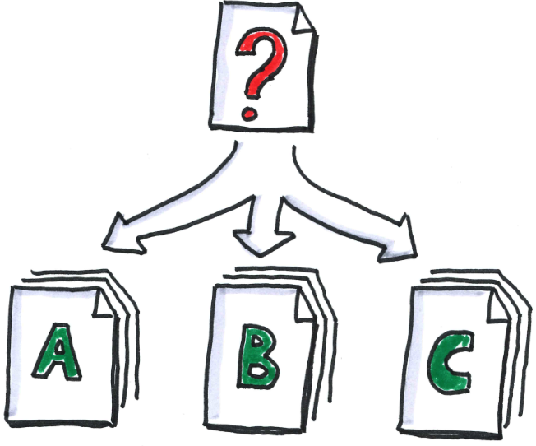
Situational Leadership model - Hersey & Blanchard (1970s)
There is no “best way” to lead a team
Leaders should adapt their leadership style to the maturity (or readiness) of their followers and also the situation
Model:
Four levels of follower “maturity”
Four leadership styles – based on task and relationship behaviour
Notes:
Image: http://www.metcalf-associates.com/wp-content/uploads/2014/07/Analysis-cc-ollver-tacke.png

Slide 12
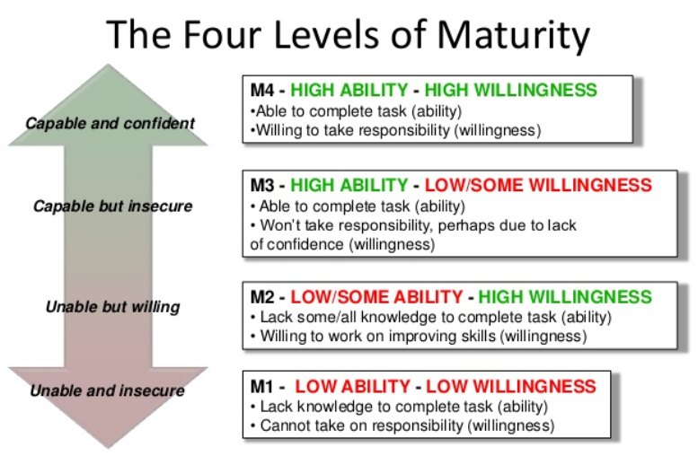
Situational Leadership Model (Hersey & Blanchard)
Notes:
Image: https://image.slidesharecdn.com/situationalleadershippresentationslideshare-130807063813-phpapp01/95/situational-leadership-step-by-step-presentation-v10-4-638.jpg?cb=1375857549
In different variations of this model, team maturity (“M”) might alternately be called team readiness (“R”) or team developmental level (“D”) – regardless, the general idea is the same.

Slide 13
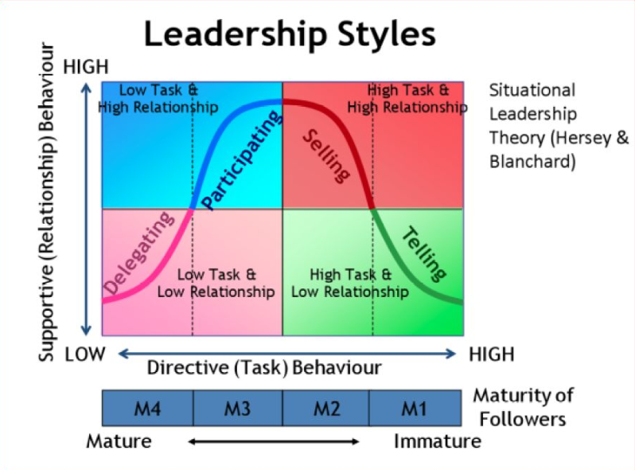
Situational Leadership Model (Hersey & Blanchard)
(video)
Notes:
Image: https://topazsmartd.files.wordpress.com/2014/05/situational-ldr.jpg
In different variations of this model, team maturity (“M”) might alternately be called team readiness (“R”) or team developmental level (“D”) – regardless, the general idea is the same.
Telling = Directing
Selling = Coaching
Participating = Supporting

Slide 14
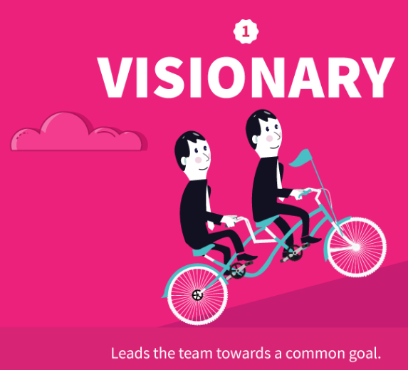
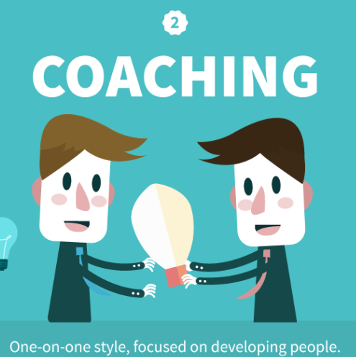
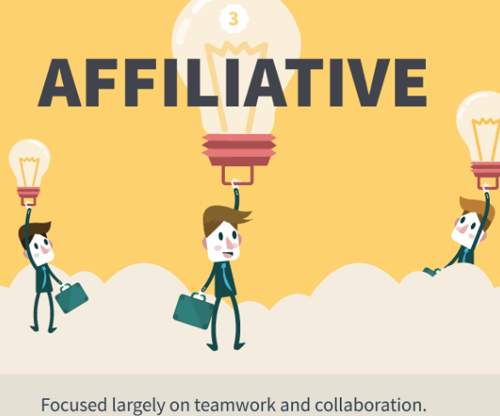
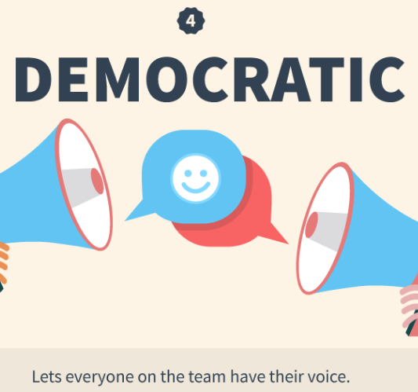

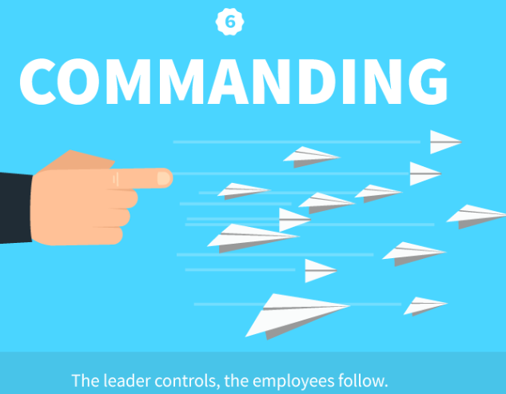
Goleman’s six leadership styles (2000)
Each style is linked to different emotional intelligence competencies
Great leaders should adopt the right style to fit the situation
But… some styles should be used more (or less) often, because of effect on organizational climate (see slide note)
Use more: Affiliative, democratic, coaching
Use less: Coercive, pacesetting
(video)
Notes:
Images: https://www.business2community.com/leadership/6-different-leadership-styles-need-know-01540019
Interested in learning more about this model? Check out Goleman’s original article that appeared in the Harvard Business Review publication in the spring of 2000: https://nealandministries.files.wordpress.com/2012/02/goleman-leadership-that-gets-results.pdf
From page 3 of the link above: “[Climate] refers to six key factors that influence an organization’s working environment: its flexibility—that is, how free employees feel to innovate unencumbered by red tape; their sense of responsibility to the organization; the level of standards that people set; the sense of accuracy about performance feedback and aptness of rewards; the clarity people have about mission and values; and finally, the level of commitment to a common purpose”

Slide 15
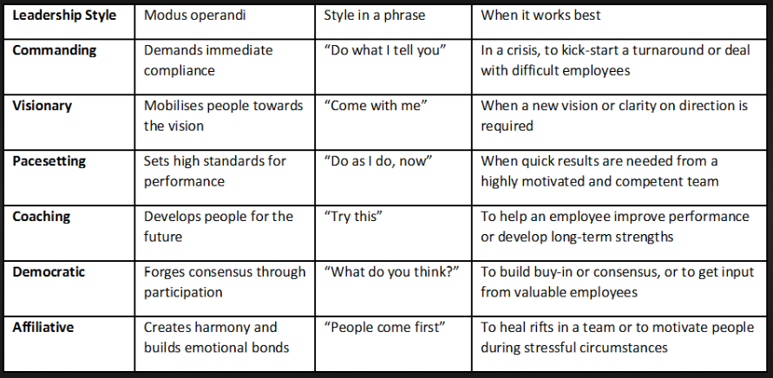
Goleman’s six leadership styles

Slide 16
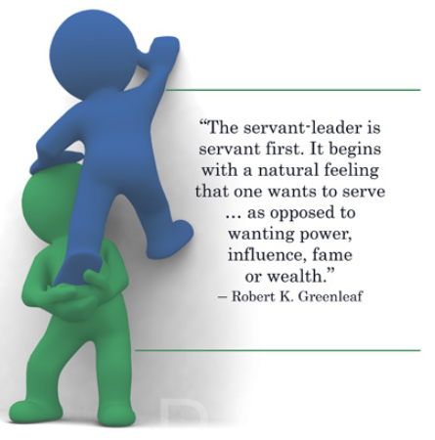
Greenleaf’s Servant leadership (1970)
(video)

Slide 17

Servant leadership
Give the team what it needs to achieve its goals
Provide resources, a productive work environment, information, etc., so the team can flourish
You take care of external distractions and administrative duties, let the team focus on their jobs
Skills and behaviours: listening, empathy, fostering trust and sense of community, self-awareness, persuasion, mentoring, team growth
Criticisms:
May not work if followers aren’t open to being guided/ supported/ empowered
Conflicts with other principles of leadership (e.g., directing work, concern for results
Notes:
Image: https://assets.entrepreneur.com/content/3x2/2000/20180123223558-GettyImages-518177730.jpeg?width=700&crop=2:1
Information Source: https://www.projectmanager.com/blog/manage-servant-leadership

Slide 18
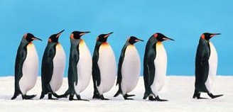
Implications for project leaders
Familiarize yourself with different leadership styles
Understand what your ‘dominant’ or natural leadership style is
Recognize that you might need to change your leadership style to suit the situation and the people you are leading
Be mindful of the consequence of your leadership behaviour
Is it effective?
Is it motivational?
Does it align with the desired culture?
Notes:
Image: https://www.livingmoreworkingless.com/wp-content/uploads/2015/03/leadership-penguins.jpg

